Slide 1
Automatic Arm Warmer
Georgia Institute of Technology - ECE 4781 - Biomedical Instrumentation
Samuel Ruiperez Campilo, Joseph Doughty, Anand Dugad, Jae Hyun Kim, Samruddhi Kulkarni
December 4th, 2018

Slide 2
Table of Contents
Problem
Statement
Solution Overview
Design
Conclusions
Physiological Responses
Description
Prototype
Block Diagram
Microcontroller
Temperature
Shivering
Finger Flexion
Algorithm
Results
Barriers
Future Work

Slide 3
Problem Statement
People who are frequently exposed to cold environments may experience a higher likelihood of the following [1, 2, 3, 4, 5]:
Cold stress
Hypothermia
Lower back and knee pain
Frostbite
Fatal cold-related accidents
Additionally, workers in cold environments may have lowered efficiency with handheld tools due to shivering, an involuntary bodily response to low body temperature [6]

Slide 4
Solution Overview
A prototype of a solution was designed in the form of an armband that senses when the following conditions are all true simultaneously:
Low ambient temperature
Shivering of the wearer’s arm
Flexion (closing) of the wearer’s fingers
When all three conditions are met, a heating pad activates for five minutes
This is intended to stop the arm shivering, increase work efficiency, and prevent long-term physiological effects from repeated cold exposure

Slide 5
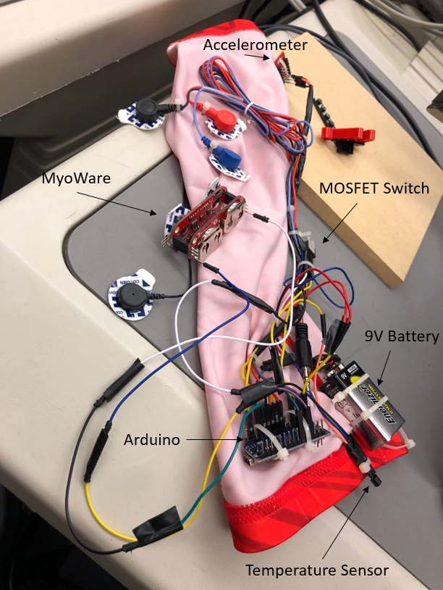
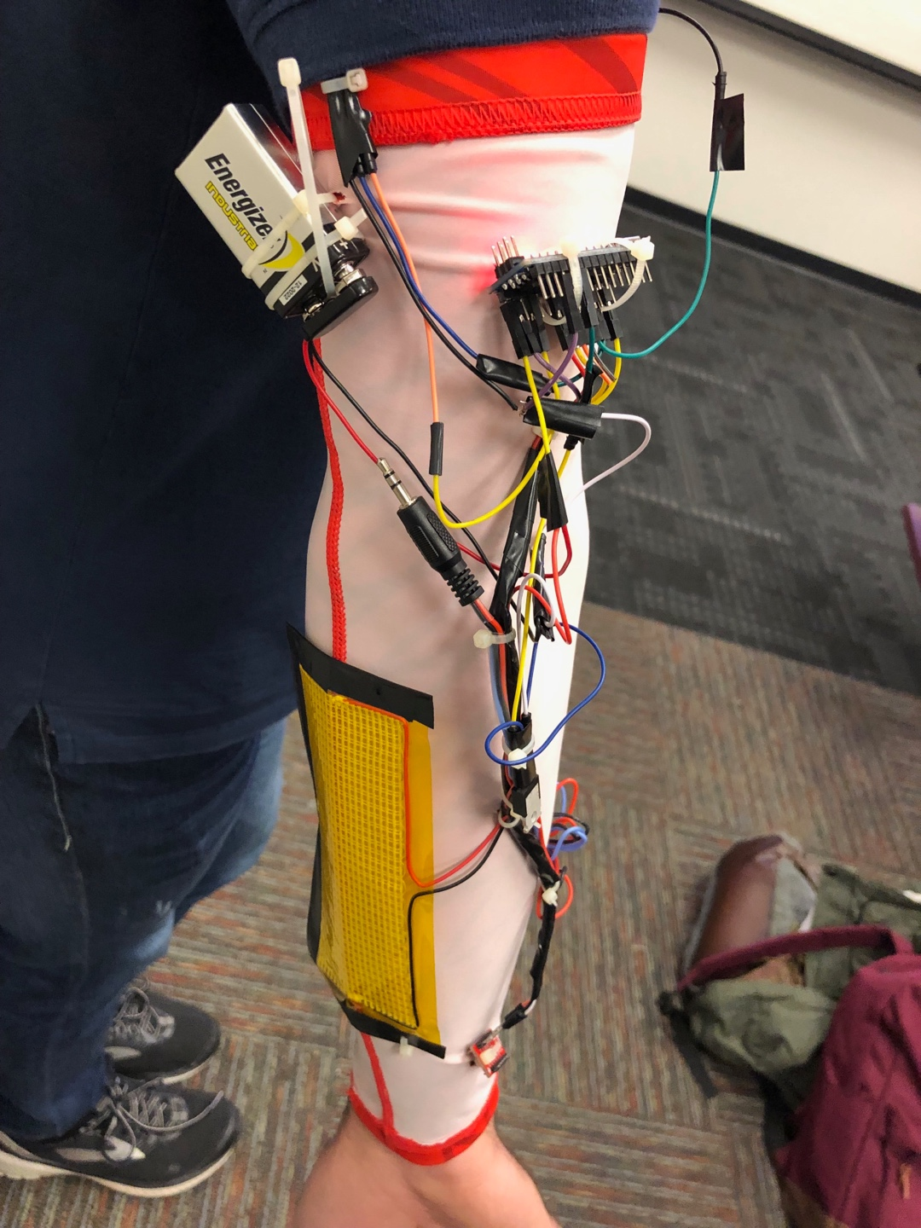
Prototype
Figure 1. Photo of armband prototype.
Figure 2. Photo of armband prototype on an arm.

Slide 6
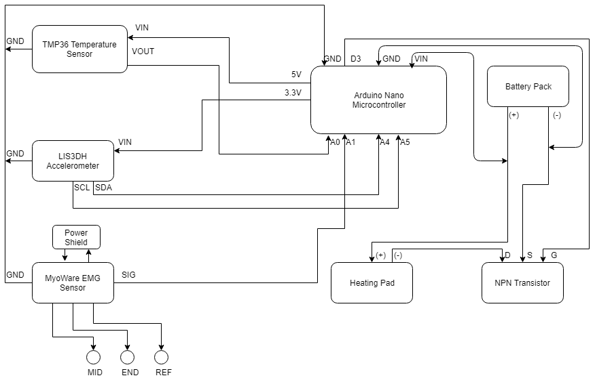
Block Diagram
Figure 3. Block diagram of the electronic system in the armband.

Slide 7
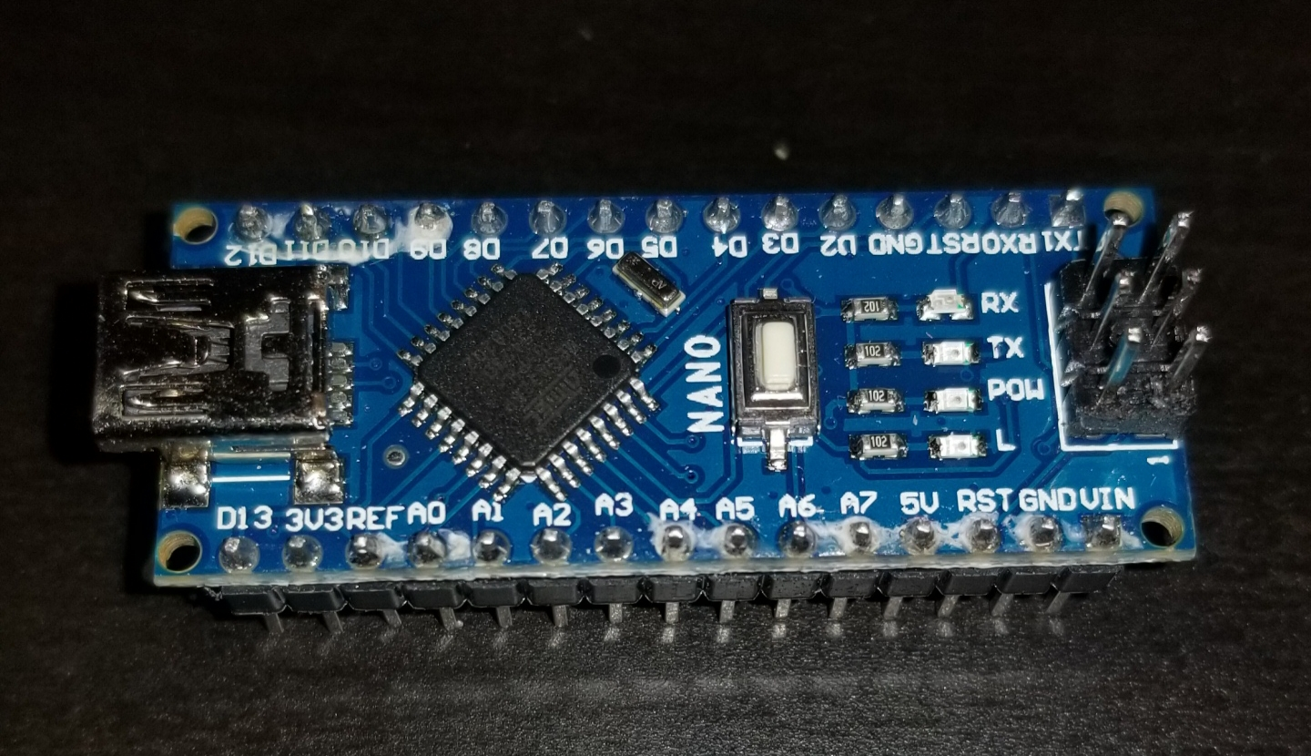
Microcontroller
Arduino Nano
Located on the upper arm
Manages input and output signals
Executes looping program to evaluate condition status
Figure 4. Arduino Nano microcontroller.

Slide 8
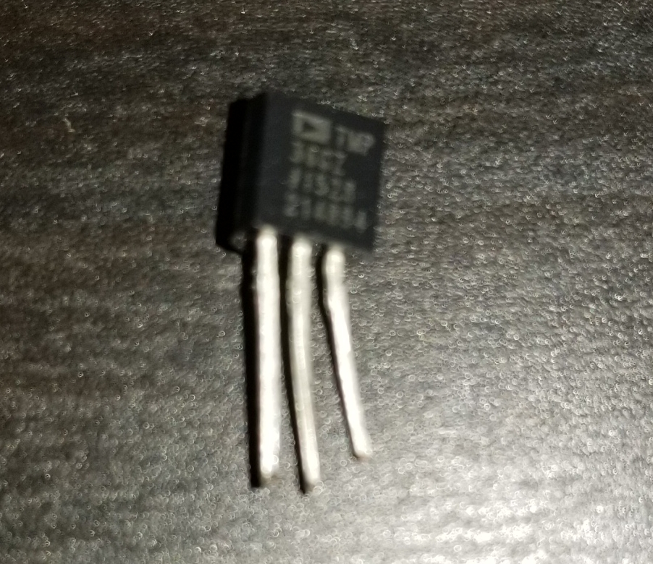
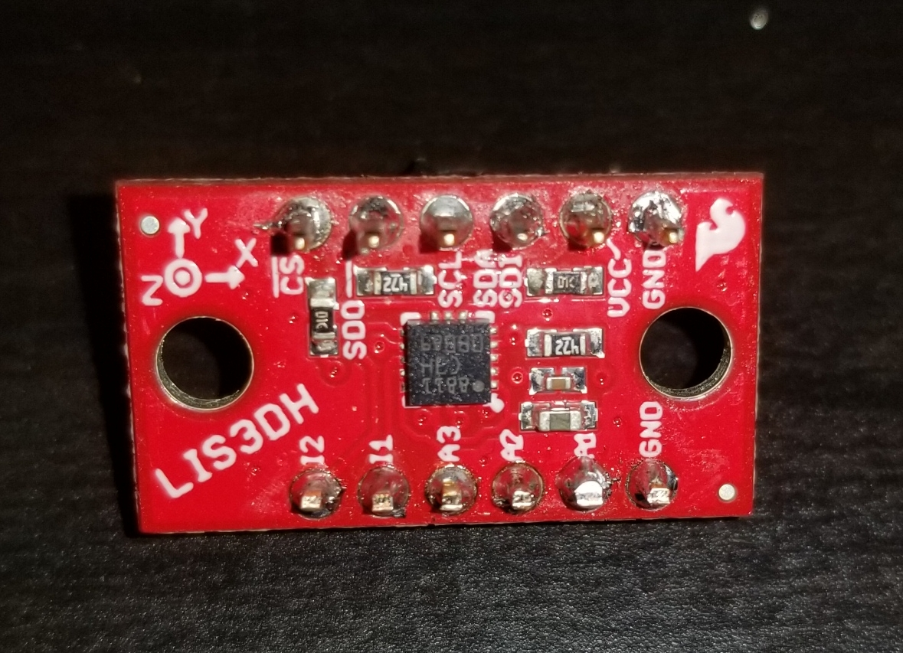
Sensing Temperature and Shivering
TMP36 Temperature Sensor
Located on the upper arm
Outputs a voltage based on ambient temperature
LIS3DH Accelerometer
Located at the wrist
Outputs signals based on x, y, and z positions
Figure 5. TMP36 Temperature Sensor.
Figure 6. LIS3DH Accelerometer.

Slide 9
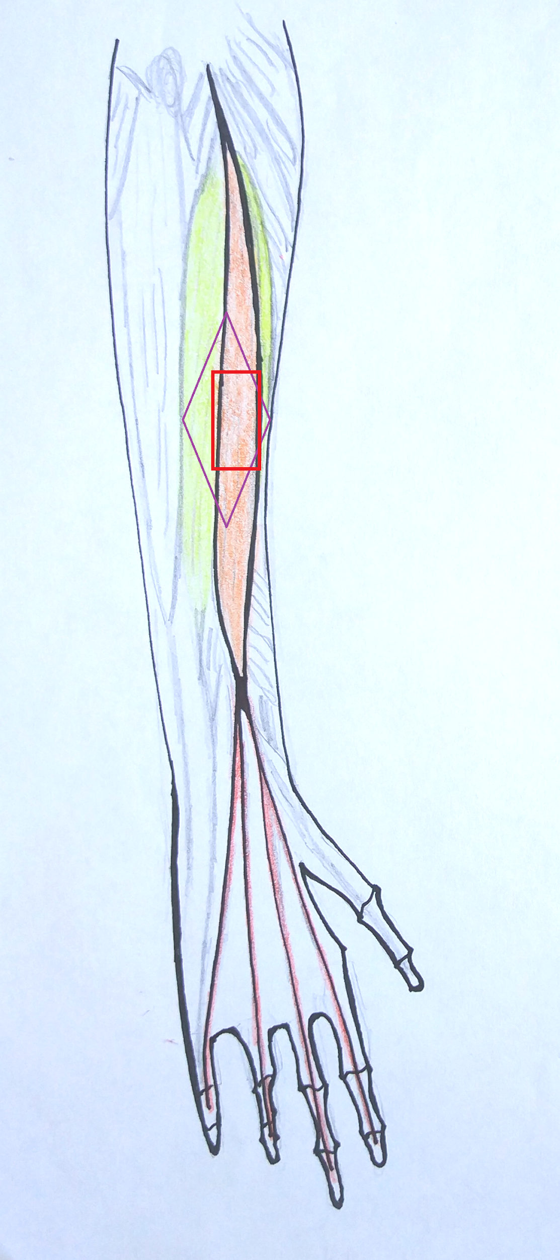
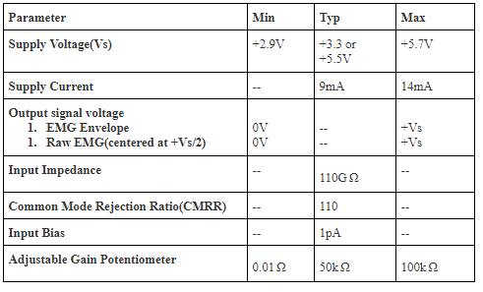
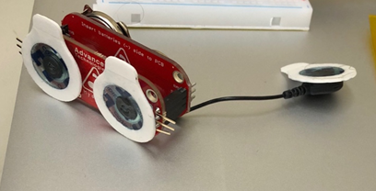
Sensing Finger Flexion
MyoWare electromyography (EMG) sensor
Electrodes placed around extensor digitorum muscle (see Figure 7)
Outputs a voltage between 0V and 3.3V based on amplitude of sensed signal
Mid and End electrodes placed near muscle of interest
Reference electrode placed near bone or less active tissue
Ground Reference
Electrode
Mid, End Electrodes
Table 1. Specifications of the
MyoWare sensor unit [7].
Figure 7. Diagram of the
right arm with extensor digitorum highlighted in orange.
Figure 8. The MyoWare sensor unit.

Slide 10
Algorithm
Program on Arduino loops every 0.5 seconds and checks readings from temperature sensor, accelerometer, and EMG sensor
If all three readings concurrently surpass thresholds defined in the program, a “high” signal is output to the gate of an N-channel MOSFET which acts as a switch between the heating pad and the battery pack
The pad will be powered for five minutes, then turned back off
If the user is still in need of warmth at this point, the pad will almost immediately be turned back on since the conditions will quickly all be true again

Slide 11
Results, Barriers, and Future Work
Results
Prototype functioned as expected based on the chosen threshold values for our experiments and demonstration
Barriers
EMG sensor didn’t get consistent readings from main muscle for finger flexion
Balancing warming strength/time versus battery capacity/physical size
Future Work
Select material which fits well, is comfortable, and protects components
Base shiver detection on actual human shiver tremor frequency
Optimize power and balance battery pack with ideal use case

Slide 12
References
[1] Y. Tochihara, et al. (2005, Feb.).“Work in Artificial Cold Environments” Journal of Physiological Anthropology and Applied Human Science, [Online]. 24(1), pp. 73-76. Available: https://www.jstage.jst.go.jp/article/jpa/24/1/24_1_73/_article/-char/en [Accessed Nov. 5, 2018].
[2] Y. Tochihara, et. al. (2007, Oct.). “Effects of repeated exposures to severely cold environments on thermal responses of humans” Ergonomics, [Online]. 38(5), pp. 987-995. Available: https://www.tandfonline.com/doi/abs/10.1080/00140139508925165 [Accessed Nov. 21, 2018].
[3] F. Chen, et. al. (1991). “A field study of cold effects among cold store workers in China” Arctic Medical Research, [Online]. 50(6), pp. 99-103. Available: https://www.ncbi.nlm.nih.gov/pubmed/1811590 [Accessed: Nov. 21, 2018].
[4] C. Bramham, et. al. (1998, Apr.). “Acute cold stress leading to elevated corticosterone neither enhances synaptic efficacy nor impairs LTP in the dentate gyrus of freely moving rats”, Brain Research, [Online]. 789(2), pp. 245-255. Available: https://www.sciencedirect.com/science/article/pii/S0006899397012651?via%3Dihub [Accessed: Nov. 22, 2018].
[5] S. B. Rutkove (2001, Jul.). “Effects of temperature on neuromuscular electrophysiology”, Muscle Nerve, [Online]. 24(7), pp. 867-882. Available: https://www.ncbi.nlm.nih.gov/pubmed/11410914 [Accessed: Dec. 1, 2018].
[6] K. Parsons (2002). Human Thermal Environments. (2nd ed.). [Online]. Available: http://soh.iums.ac.ir/uploads/0415237920_95689.pdf [Accessed: Nov. 29, 2018].
[7] Sparkfun, “MyoWare Muscle Sensor” Sparkfun.com, No Date. [Online]. Available: https://www.sparkfun.com/products/13723 [Accessed Nov. 6, 2018].

